Slide 1
Cascading Style Sheets (CSS)

Slide 2
What is CSS?
CSS stands for Cascading Style Sheets
CSS describes how HTML elements are to be displayed on screen, paper, or in other media
CSS saves a lot of work. It can control the layout of multiple web pages all at once
External stylesheets are stored in CSS files

Slide 3
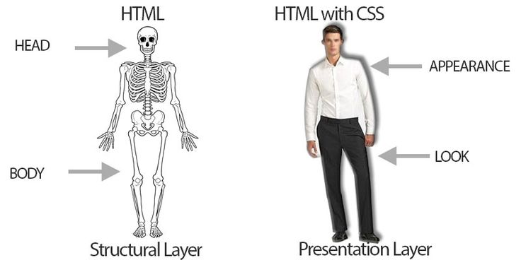
HTML CSS

Slide 4
CSS Example
body { background-color: lightblue; } h1 { color: white; text-align: center; } p { font-family: verdana; font-size: 20px; }

Slide 5
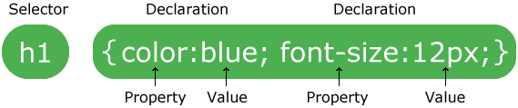
CSS SYNTAX

Slide 6
CSS Selectors
The element selector
p { text-align: center; color: red; }
The id selector
#para1 { text-align: center; color: red; }
The class selector
.center { text-align: center; color: red; }

Slide 7
Grouping Selectors
If we have
h1 { text-align: center; color: red; } h2 { text-align: center; color: red; } p { text-align: center; color: red; }
We can group like this
h1, h2, p { text-align: center; color: red; }

Slide 8

CSS Box Model

Slide 9
CSS Margins
CSS margin property is used to create space around elements, outside of any defined borders
CSS has properties for specifying the margin for each side of an element:
Margin-top, margin-right, margin-bottom, margin-left
All the margin properties can have the following values
Auto-the browser calculates the margins
length - specifies a margin in px, pt, cm, etc.
% - specifies a margin in % of the width of the containing element
inherit - specifies that the margin should be inherited from the parent element

Slide 10
Margin - Shorthand Property
If the margin property has four values:
Example
p { margin: 25px 50px 75px 100px; }
top margin is 25px
right margin is 50px
bottom margin is 75px
left margin is 100px

Slide 11
Margin - Shorthand Property
If the margin property has three values:
Example
p { margin: 25px 50px 75px; }
top margin is 25px
right and left margins are 50px
bottom margin is 75px

Slide 12
Margin - Shorthand Property
If the margin property has two values:
Example
p { margin: 25px 50px; }
Top and right margins are 25px
right and left margins are 50px
bottom margin is 75px

Slide 13
Margin - Shorthand Property
If the margin property has one value:
Example
p { margin: 25px; }
Top, bottom, right and left margins are 25px

Slide 14
CSS Comments
p { color: red; /* This is a single-line comment */ text-align: center; } /* This is a multi-line comment */

Slide 15
Resources
https://www.w3schools.com/css/default.asp

